Slide 1
信息可视化设计
工作框架
2018 专题设计4 秋季班

Slide 2
信息图形设计: 工作框架
一个成功的信息图形设计需要面临3个主要的挑战：
1-明确需要传达什么样的信息：无论是空间的、时间的还是数量的信息（通常情况下需要传达的信息往往是上述三类信息的复合体）
2-需要对信息内容及其表达方式进行整体的构思：不仅仅是将图形图像、表格、地图等集合在一起，更需要综合各内容进行系统的考虑。
3-为需要表达的信息选择一种最佳的表达方式：静态的、动态的还是交互的。

Slide 3
信息图形设计工作框架
信息类型
空间
用于描述物理或概念空间中的地理位置关系和空间关系的信息
时间序列
用于描述物理或概念的时间链中的位置和关系序列的信息
数量
用于描述空间和时间上有关尺度，比例，变化和数量的组织结构方面的信息
信息图形工具
图表
Icon: 对显示对象的视觉化简化
Sequence: 事件、活动和因果关系的递进步骤
Process: 对时间和空间维度成步骤的互动信息的呈现
Timeline: 呈现随时间推进而具备的演化
Exposition: 呈现人眼观测不到的信息，如剖面，轴测图等
地图/定位图
Locator: 呈现相关事物之间的位置关系
Data: 呈现与地理位置相关的数量信息
Schematic: 对地理，流程，序列 的抽象表达
表格
Flow: 呈现随时间变化所呈现的量的变化
Bar: 呈现量的比例比较
Pie: 呈现整个的各部分的分配关系
Organization: 呈现一个结构的各部分及其相互关系
信息图形
信息传达方法
静态
一眼即能看到全貌的信息表达方式，如报纸中的图形，地图，产品手册等
动态
基于线性时间序列的信息的递进式表达，如动画，连环画，动态视频等
交互
根据信息阅读者的选择呈现信息内容的表达方式。

Slide 4
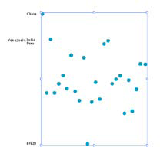
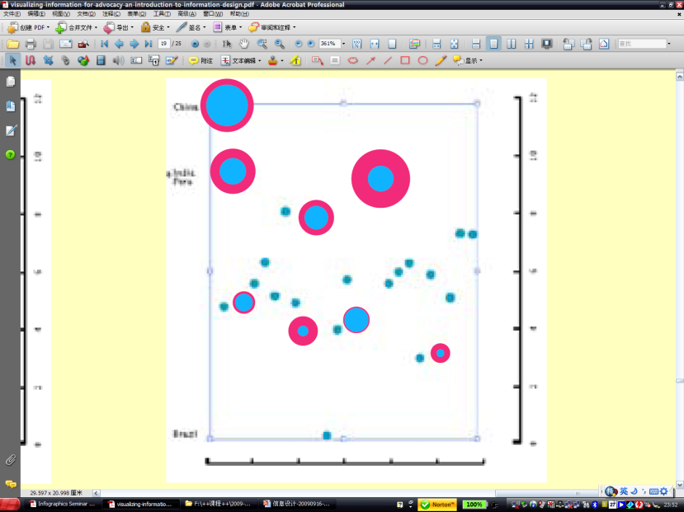
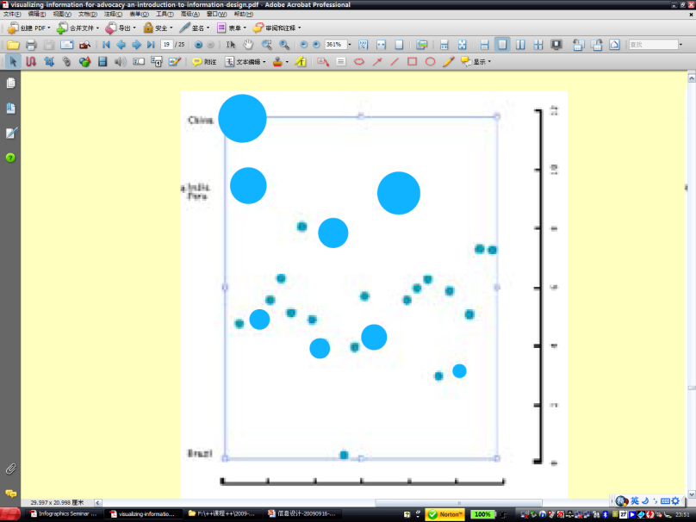
图表能够集中于单一类型信息的表达上，也能够同时呈现多重信息类型。
下面的例子表明了分别显示一种、两种、三种和四种数据类型时候的情况，所使用的可视化变量分别为位置，尺度和颜色。
单一维度的信息表达：不同国家的GDP
不同国家的GDP与国民期望的生活品质的分布，增加了生活品质数据
增加了第三个信息：国家的人口数
增加了第四个信息类型：人口统计变量信息如性别等

Slide 5
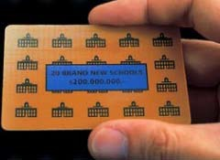
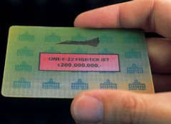
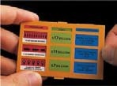
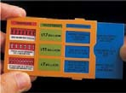
In September 2006 Amnesty International published satellite images of the Porta Farm settlement in Zimbabwe to show the destruction of more than 850 houses and structures, practically all of which are absent from the center image.
The third image indicates the center points of the destroyed structures.
Interactive, printed cards for a campaign by TrueMajority examine the enormous budget of U.S. military and reveal how the money could be better spent. The campaign urged Congress to reallocate 15% of military budget to education and health care. The cards were designed by Sagmeister, Inc.
The image on the card above changes as it is turned and viewed from different angles. The images compare the number of schools that could be built for the price of a single fighter jet.
Pulling the blue card to the right reveals a second layer of pictures and text, describing an alternative budget.

Slide 6
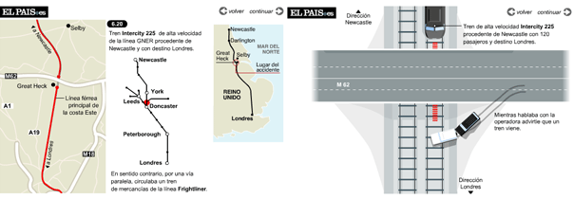
信息图形设计: 9个途径
In the last section, we understood where and how an infographic fits into the overall scheme of the information design process. In this section, let‟s glean some design strategies by analyzing some successful infographics.
1. ORGANIZE信息组织: Organizing the available information and coming up with a plan for presenting it is the first and probably the most difficult stage in designing any infographic. The train accident infographic explains the collision of two trains triggered by an automobile veering off a nearby highway. The key to reconstructing an event like this is to establish the role of geography, the cause, the chronological sequence, and the facts of the objects involved. All of these pieces of information have to be organized effectively with right amount of detail and emphasis to make sure the viewer experiences the incident as an authentic whole.
2. MAKE VISIBLE信息视觉化: It is the essential quality for an infographic. The fishermen of Marshall Islands have for centuries used maps made using shells tied together by bamboo sticks, to visually represent the distance between the various islands, their locations with respect to each other, and the direction of currents.
Anatomy of an accident, El Pais.

Slide 7
3. ESTABLISH CONTEXT创建视觉化的环境: Going back to the train accident example, establishing context begins with locating the geography of the accident site so that the viewer get the bearings on the topography of the event. The designers have chosen the top view because the key components are the highway and the tracks below. Notice the view is closer when the first collision happens and gets wider during the second collision. Through this the difference in scale of collision is established. The viewer is able to experience the fact that a small vehicle has triggered a catastrophic collision.
4. SIMPLIFY简化: Representations that are simple and direct are easier to interpret. We get easily distracted by extraneous properties of representation. The NYT graphics on the spread of the SARS virus exemplifies the principle of simplicity – most notably in its visual treatment of the map and use of colors. The graphic talks about a spread from country to country. Hence a coarse representation is good enough to convey that message. Colors are used to indicate the primary, secondary and tertiary spreaders of the virus and it is critical piece of information. Hence you see only 3 colors in the entire graphic.
5. ADD REDUNDANCY增加必要的附加信息: Redundancy is a concept which has emerged from the information theory to communication. Redundancy is the opposite of information. Something that is redundant adds little, if any, information to a message. Yet much of the information we deal with in everyday life contains a good deal of redundancy.
The English language, for example, can be mostly understood if you remove the vowels. Cnsdr ths sntnc, fr xmpl. One of the purposes of adding redundancy to a stream of information is to make it easier for us to digest information. Although the sentence without vowels can be read, it is harder to read. On a noisy transmission channel, the redundancy enables the reader to correct errors that may have been introduced into the stream of information. Noise is any factor in the process that works against the predictability of the outcome of the communication process. For example, traffic lights communicate through color. They also use position to reinforce the message.
While adding redundancy offsets noise, too much redundancy is inefficient. Using repetition, reiteration and restatement, we run the risk of burdening or boring the audience. So, maintaining an optimal balance between predictability and uncertainty is the key to success in communication.
Shell Map, Marshall Islands.

Slide 8
How SARS spread, The New York Times.

Slide 9
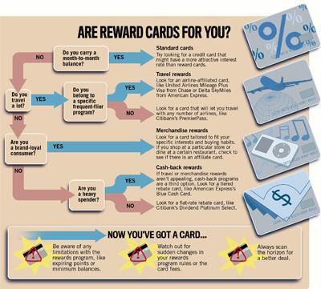
6. SHOW CAUSE AND EFFECT显示事件的因果关系及机制: When we try to comprehend something, we are looking for information to understand the underlying mechanisms. Reasoning is about examining causality. Earlier we saw an example which shows cause and effect in of Dr. John Snow's medical detective work in which he identified the cause of Cholera epidemic in London. Similarly the decision diagram (fig.27), lucidly shows the cause and effect by taking the viewer through a decision diagram about whether a particular is suitable for them or not.
7. COMPARE AND CONTRAST建立对比关系凸显主要信息: Together with what is the cause, and what is the effect, the third important question that needs to be answered is, compared to what? In the NYT graphic on the spread of SARS, comparison comes across through the use color-coding, which differentiates primary, secondary and tertiary infections. Dots are used to indicate the number of infected people. This helps us to make a quick visual comparison of the volumes infected people across different countries.
Decision Diagram. Are Reward Cards for you?
How to dance the electric slide. Wordless Diagrams, Nigel Holmes.

Slide 10
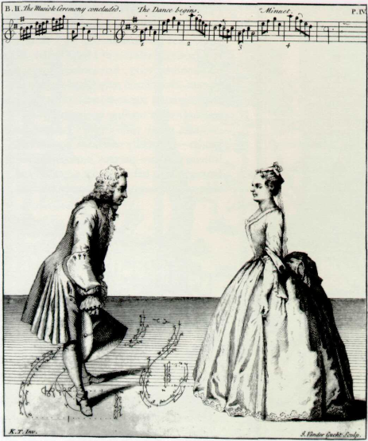
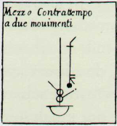
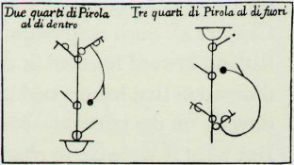
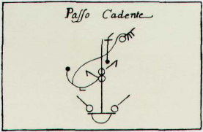
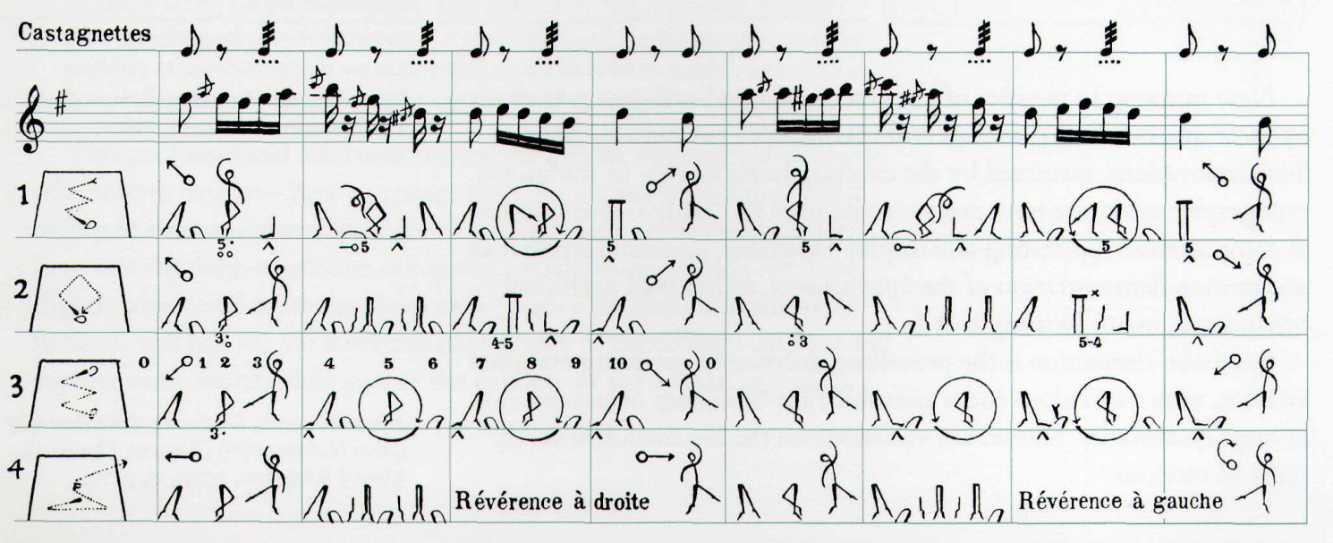
Kellom Tomlinson, The Art of Dancing,
Explained by Reading and Figures (London,
1735), book II, plates IV, XIV, VIII, VI.

Slide 11
8. CREATE MULTIPLE DIMENSIONS在可视化内容中运用多个维度来表达信息: We saw earlier the graphic by Minard in which he manages to portray six dimensions - the size of the army, latitude, longitude, direction the army is moving, temperature, and date. On a single sheet of paper with no text, he eloquently captures Napoleon's failed march to take Russia. The NYT SARS graphic too is multi-dimensional. The graphic informs us about space (map of South East Asia), volume (numbers of infected), and movement of infected people (arrows to indicate the direction of spread).
9. INTEGRATE整合: It is importance to tell a "coherent story". This means avoiding references for figures and examples, which are physically removed from the flow of the text (fig.29). Also information for comparison should be put side by side. That is, within the eye span, not stacked in time on subsequent pages. This document tries to present a coherent story by placing visual and references within the eye span and not at the end as an appendix.
Gray‟s Anatomy. Words well integrated with the image.

Slide 12
Patching the levee in New Orleans, L.A. Times.

Slide 13
信息的整合设计
设计目标
受众
信息内容与数据类型
信息传达的方式
媒体

Slide 14
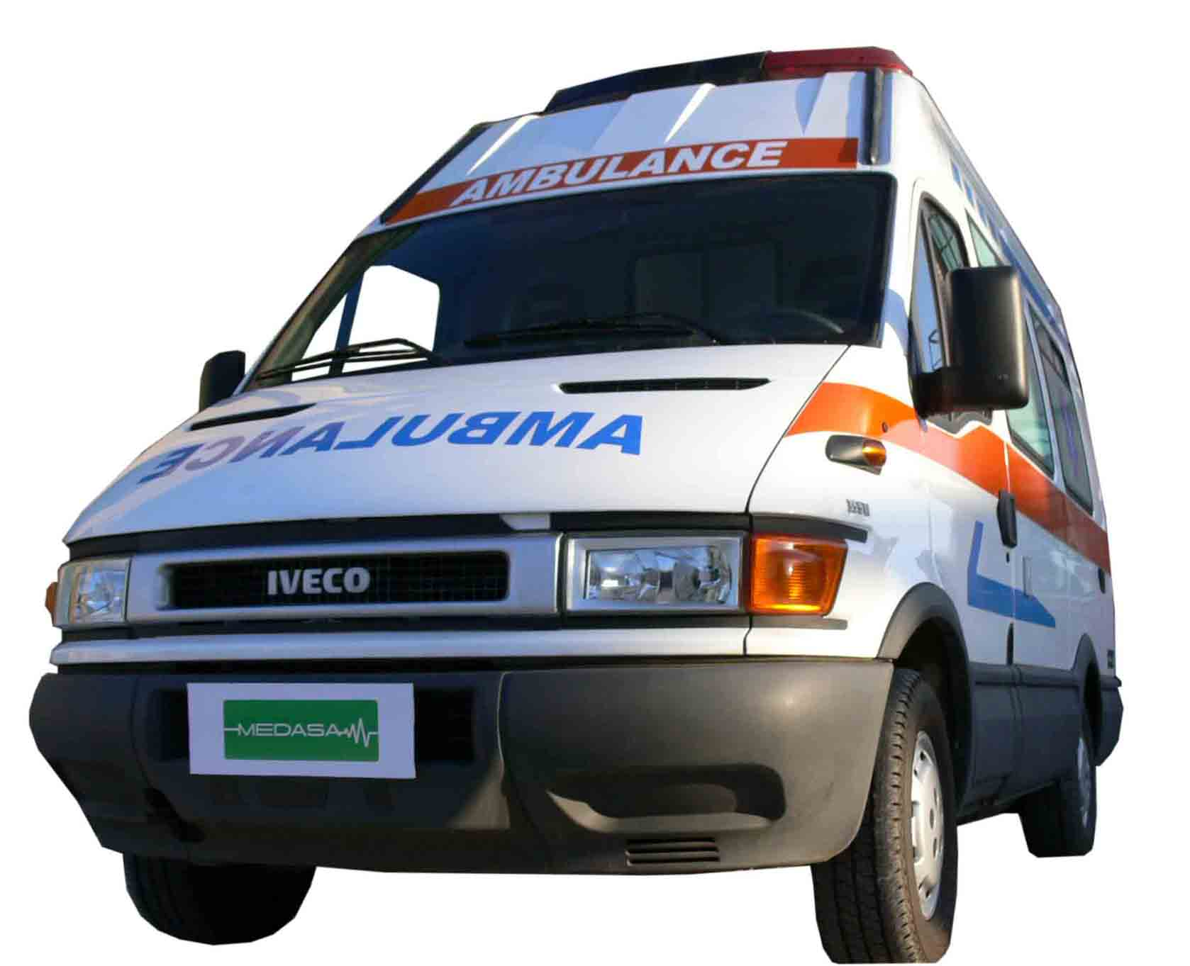
信息认知：受生理、认知、文化、教育背景、政治经济、生活习性等的影响和信息发布环境的影响。

Slide 15
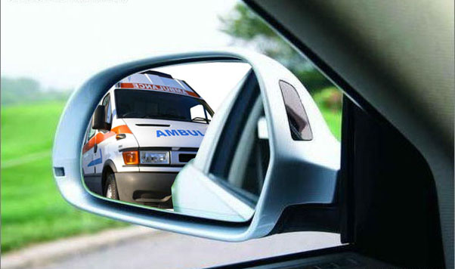

Slide 16
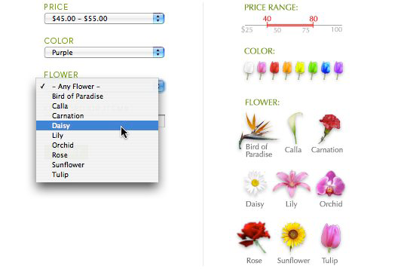

Slide 17
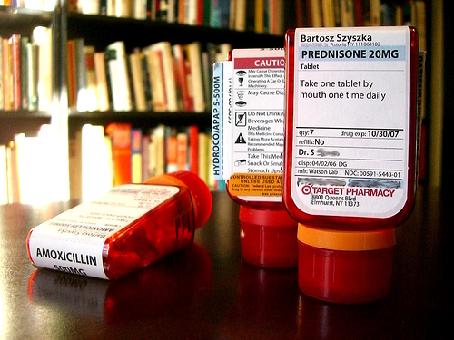
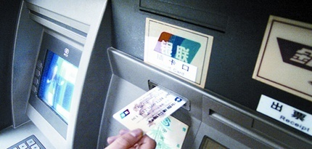
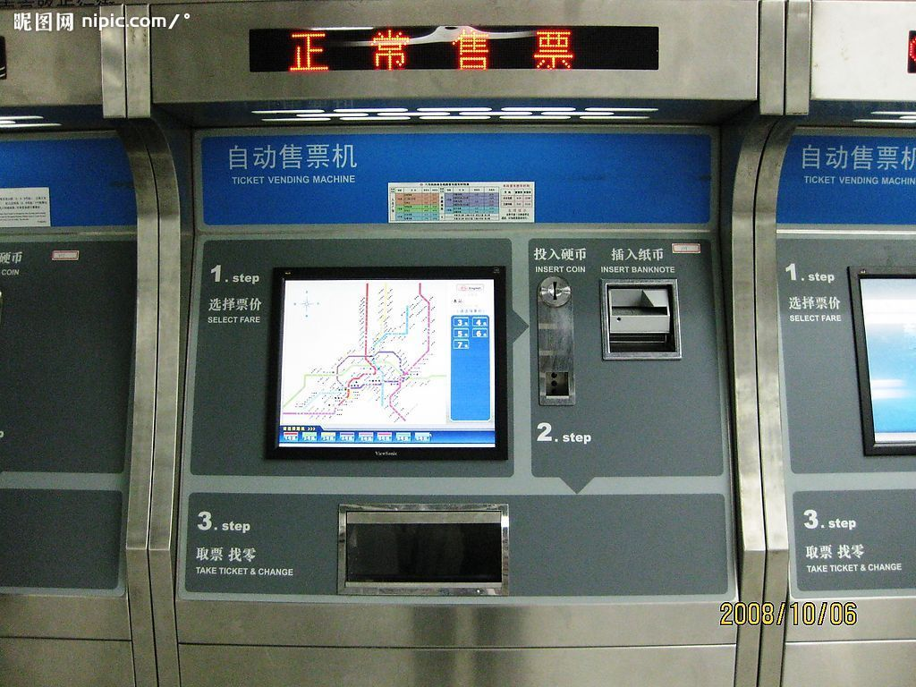

产品？
还是服务系统的部件？

Slide 18
信息的整合设计：
1-规划前的四个问题
1-表格、图表和地图分别适合于哪些信息和数据的视觉化
地图适合表达空间和位置信息；
表格适合表达数量和基于时间的趋势信息；
图表和流程表适合表达过程和关系。
2-信息内容-应该关注哪些信息，应该排除哪些信息
需要了解：
• 准备提供什么样的信息内容；
• 提供给谁；
• 如何投放和传达。
3-使用信息表达的策略是什么
信息设计的成果服从于什么样的活动？广告，公益宣传或其他。
4-你希望得到的结果是什么
信息设计成果在完成传达后的预期目标是什么？

Slide 19
信息的整合设计：
2-关于信息设计的受众
1-信息设计是有着明确目的性和受众的设计，完全不同意纯艺术表达。
2-在了解目标受众的前提下，将信息内容与色调，风格，信息表达格式综合考虑。目标受众如何阅读信息？你的目标受众对这些信息已经不陌生还是初次接触，如果信息设计是服务于某一活动的话，这些受众是该活动的旧目标还是新目标？
3-不同的受众需要采用不同的信息表达的手段来应对：如面向年轻人和面向政府关于的时候，需要不同的信息表达形式。
4-为受众而设计，而不是为你自己设计
5-采用UCD的设计流程更有助于达到目标
了解受众特点，认知风格与偏好，信息访问的习惯等等
6-信息表达不要呈现个人的偏向，公平的呈现信息内容（数据），揭示数据背后的潜在关系，评价留给受众。

Slide 20
信息的整合设计：
3-数据的评估
1-设计之前需要对我们所能获得的数据资料加以评估
2-应该收集哪些信息
准备讲述什么故事？它的背景和事实是什么？讲述故事比起提供数据表格更能使受众留下印象。
3-我们手头有哪些信息，分别是什么类型的（质的或量的）
信息设计有助于让数的信息和量的信息更具吸引力。
4-手头的信息具有说服力吗？
采用UCD的办法：参与式设计
5-哪些信息是关键信息，哪些是重要信息，为了清晰表达主题，需要对信息进行简化

Slide 21
信息的整合设计：
4-简明准确的信息设计的一些基本原则
• 明确最为重要的信息是什么？将最重要的信息以最显著的方式表达与呈现。
• 简洁：在设计时，去除什么信息与保留什么信息同样重要。需要认识到在同一个页面里的每个要素相互之间都是竞争关系，要让重要的信息脱颖而出，让每个元素都是为达成有效传达的目的不可缺少的元素。
• 注重对信息比较，对比和差别的呈现，这样既能使得信息内容更为生动，同时这也是人们感知和获取信息的主要途径和方式，可视化变量能够传递丰富的信息。
• 使用的文本语言是否易于准确理解？
•字体是否清晰且易于受众迅速捕捉到内容大意。文本的大小和格式本身也能承载和传递信息，但是不能建立在牺牲信息表达需简明准确的基础上。
• 标题是否鲜明和清晰表达内容，是否易于理解，能够代表信息内容吗？
• 你所使用的图形是否需要一些图例来标识图形和符号的含义？
• 参考文献标识是否清晰，列出设计中所参考的文献（信息数据的来源）会使数据具有权威性，也能够作为证据。
• 设计时需要考虑信息设计成果发布的媒体形式的优点和局限。

Slide 22
信息的整合设计：
5-其他一些设计要点：
• 在使用电脑之前，先完成所有的设计草稿。技术会限制设计师的创意发挥。
• 人们会在阅读文字之前先读图，因此所涉及的图形尽量做到内容独立完整，另外对信息的总结归纳可以用简洁的标题呈现，言简意赅。
• 图形要能够表述相对完整的信息内容（故事），设计时需要考虑让图形越简洁越好。
• 在条件允许的前提下尽量呈现实际数据，人们处理大量信息的能力很强，设计师的工作是将数据背后的模式展现出来，帮助受众厘清数据之间的关系和内涵。
• 非数据性元素在设计中使用越少越好。如非必需，方框，各种装饰线条，彩色背景，网格，阴影和其他装饰元素都可删除。如果必须保留的话，可以做一些弱化处理，如淡色，细线，点化线等。
• 尽量减少和简化解释信息内容所必需的过程步骤。重要信息如果能够以标题的形式呈现，就不要放到文本块中。或者以醒目的字体（特异但符合整体风格）让信息内容凸显出来。
• 提供与信息内容（故事）密切相关的背景信息，具体方式可以灵活运用。
Adapted from Mike Dickison’s Tip List, http://numberpix.com/2007/02/mikes_tip_list.html

